Slide 1
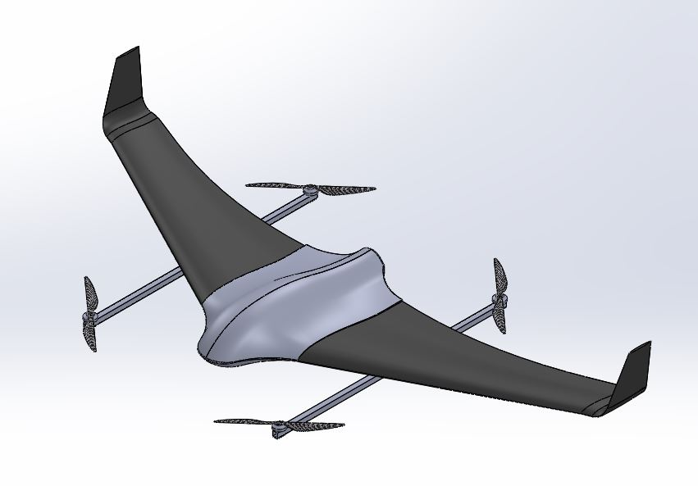
ME FYP Progress Report
01/11/2021
Cheung Hiu Ching, Athena
Fung Ka Chun, Tim
Liu Sum Yin, Kylie

Slide 2
CONTENTS
01
03
Current progress
Interim report
02
Future plan

Slide 3
01
Current progress

Slide 4
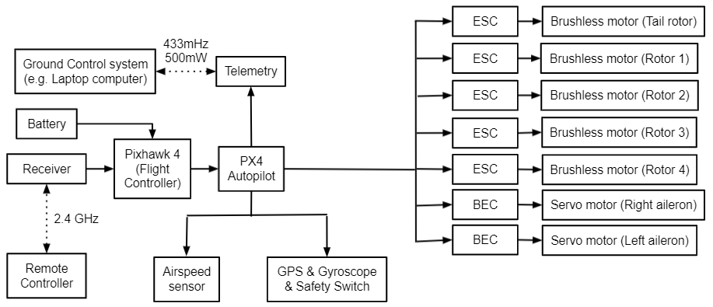
Current progress: Building Skywalker X8

Slide 5
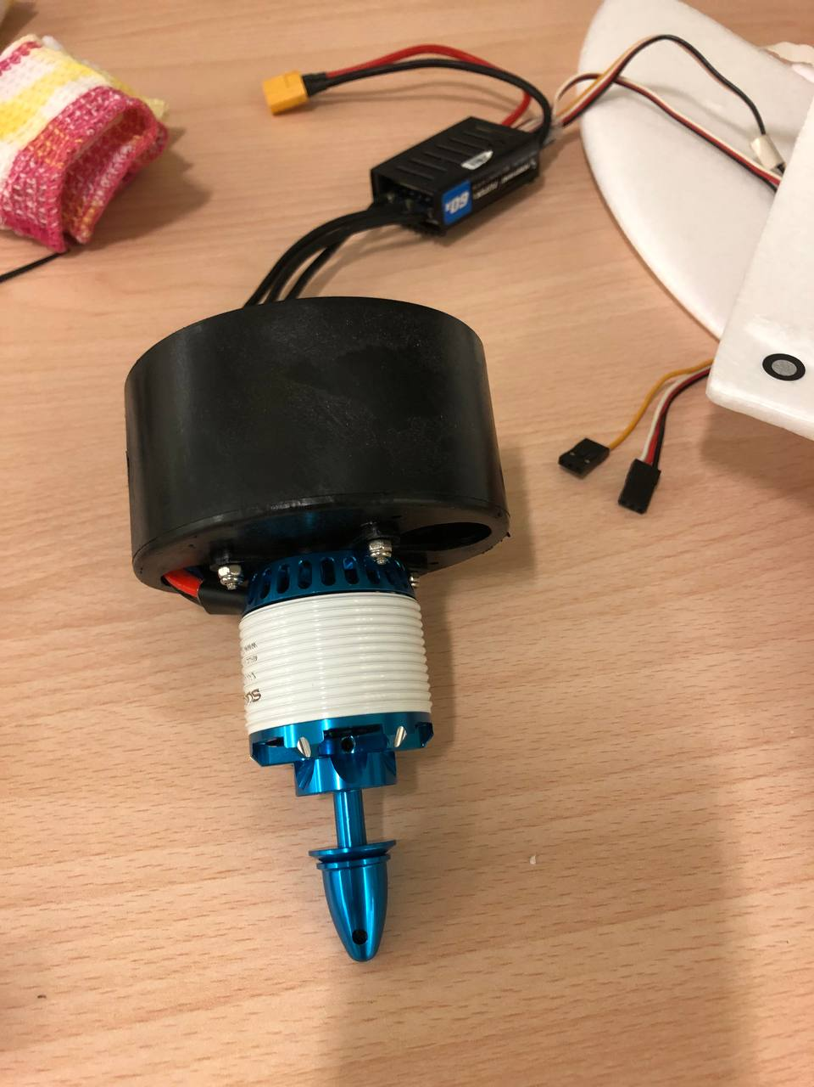
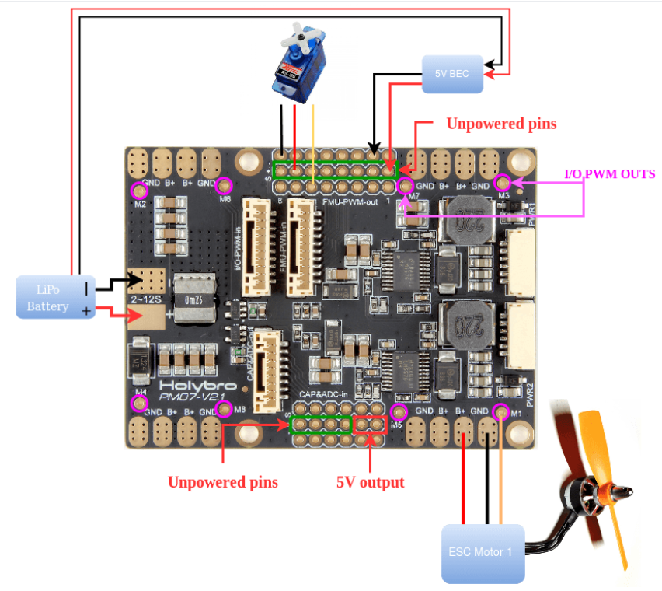
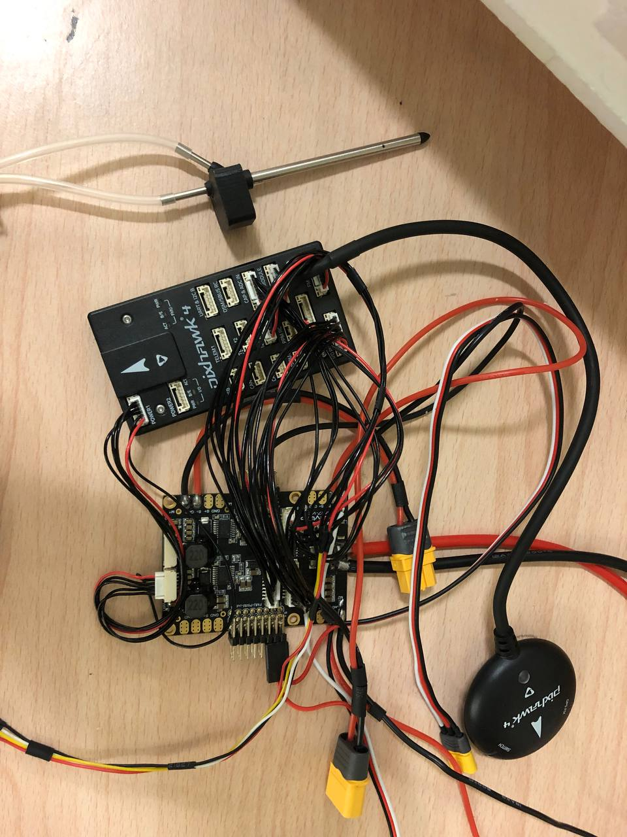
Current progress: Building Skywalker X8

Slide 6
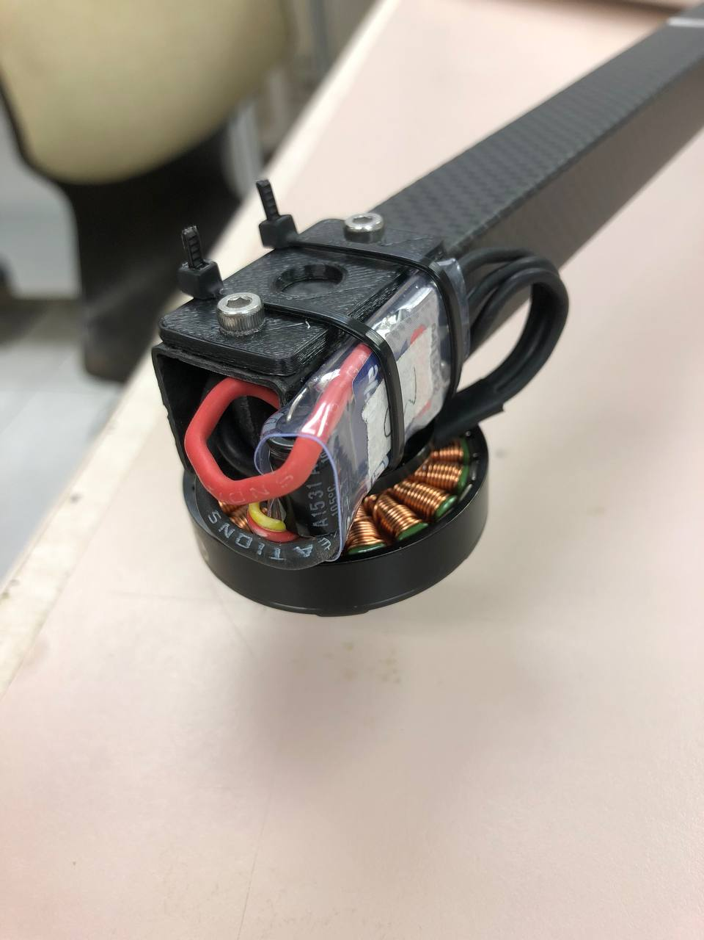
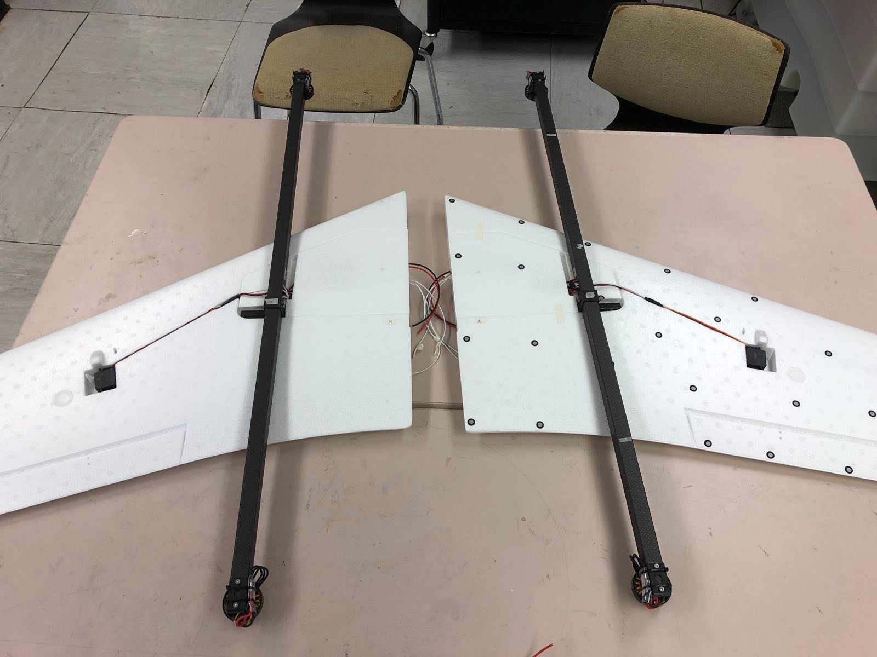
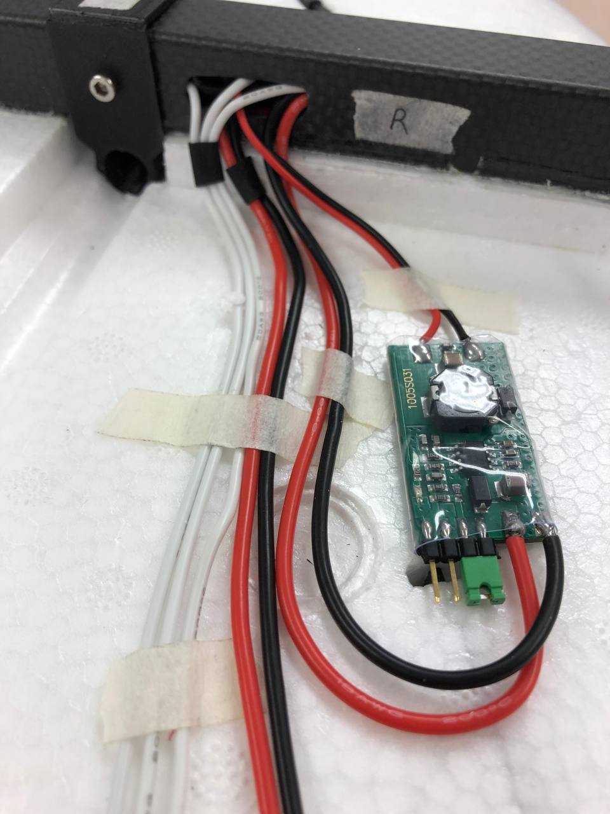
Current progress: Building Skywalker X8

Slide 7
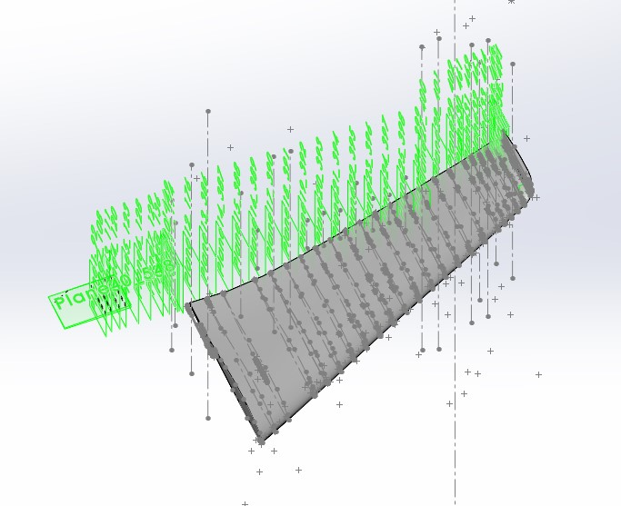
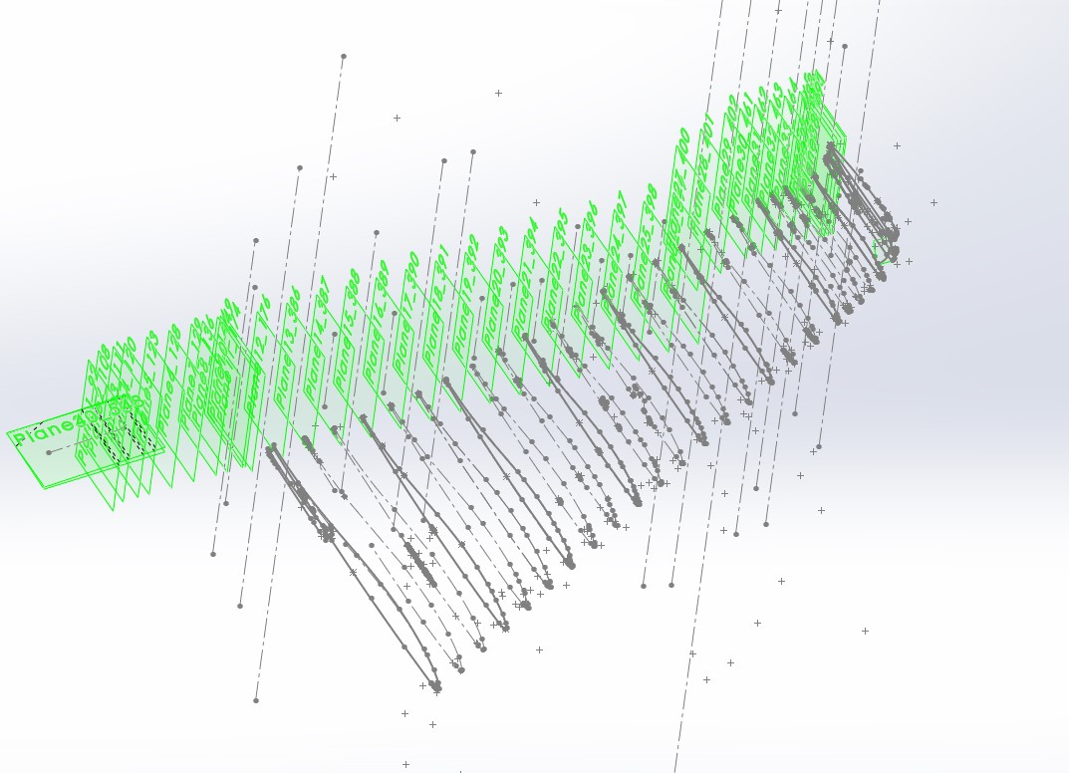
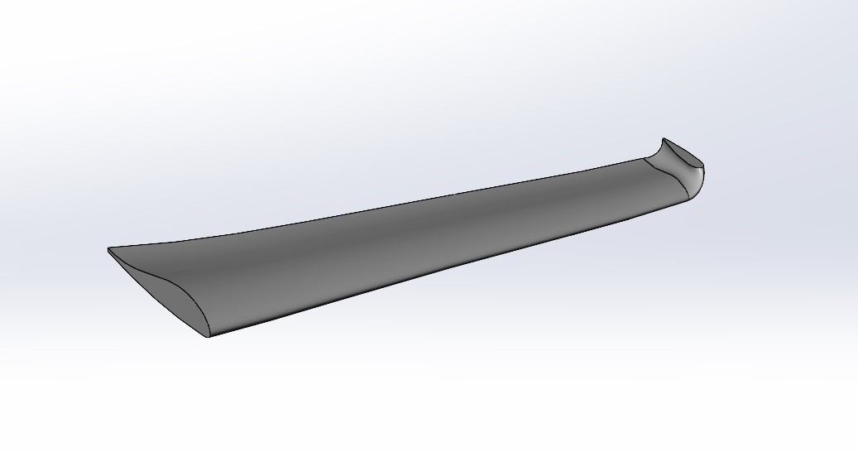
Current progress: CAD drawing of Skywalker X8

Slide 8
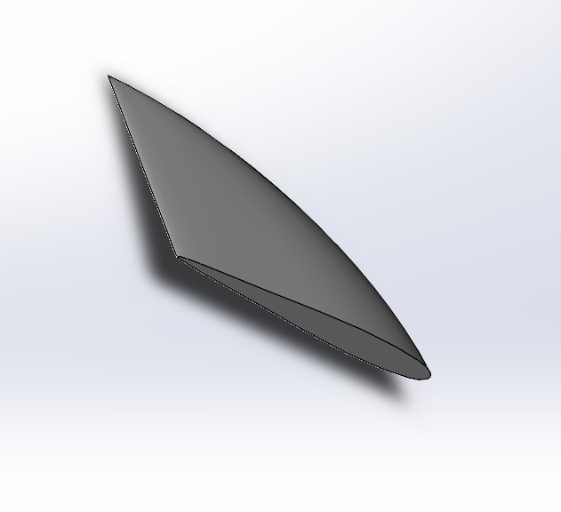
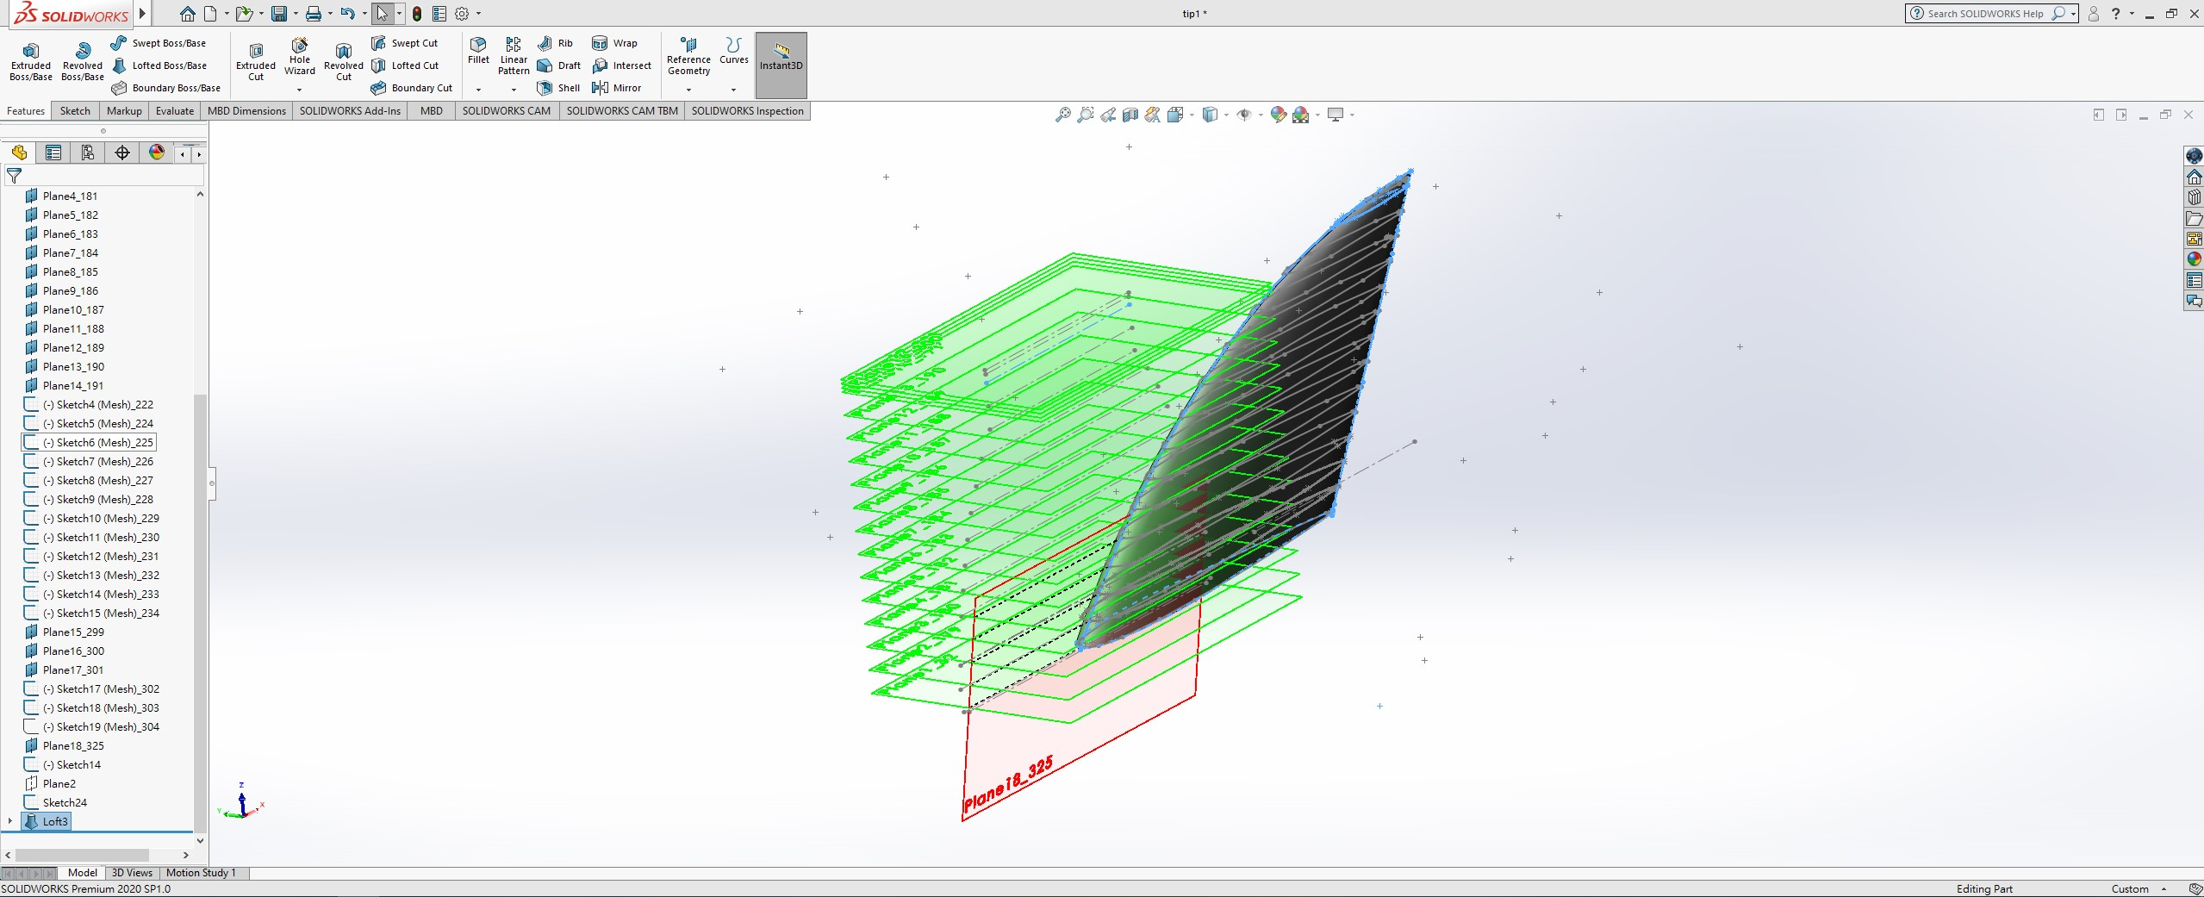
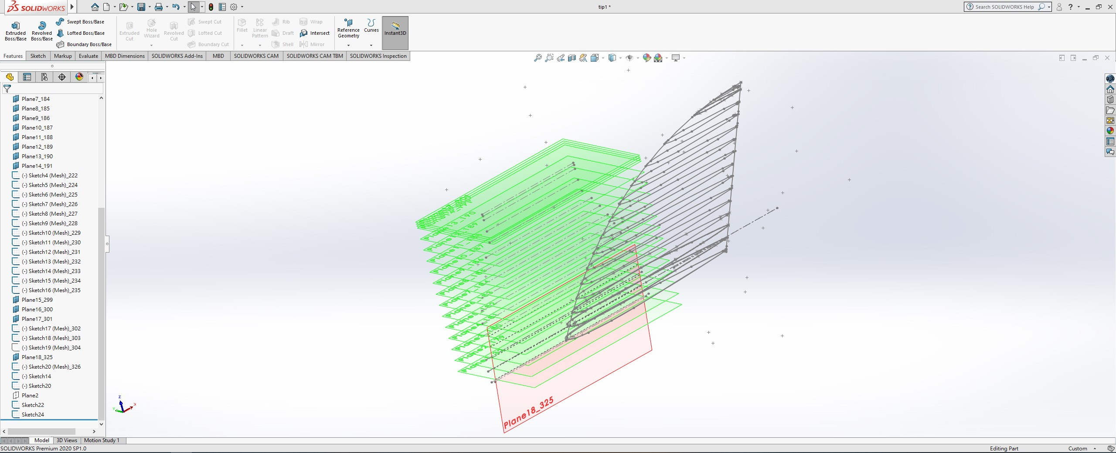
Current progress: CAD drawing of Skywalker X8

Slide 9
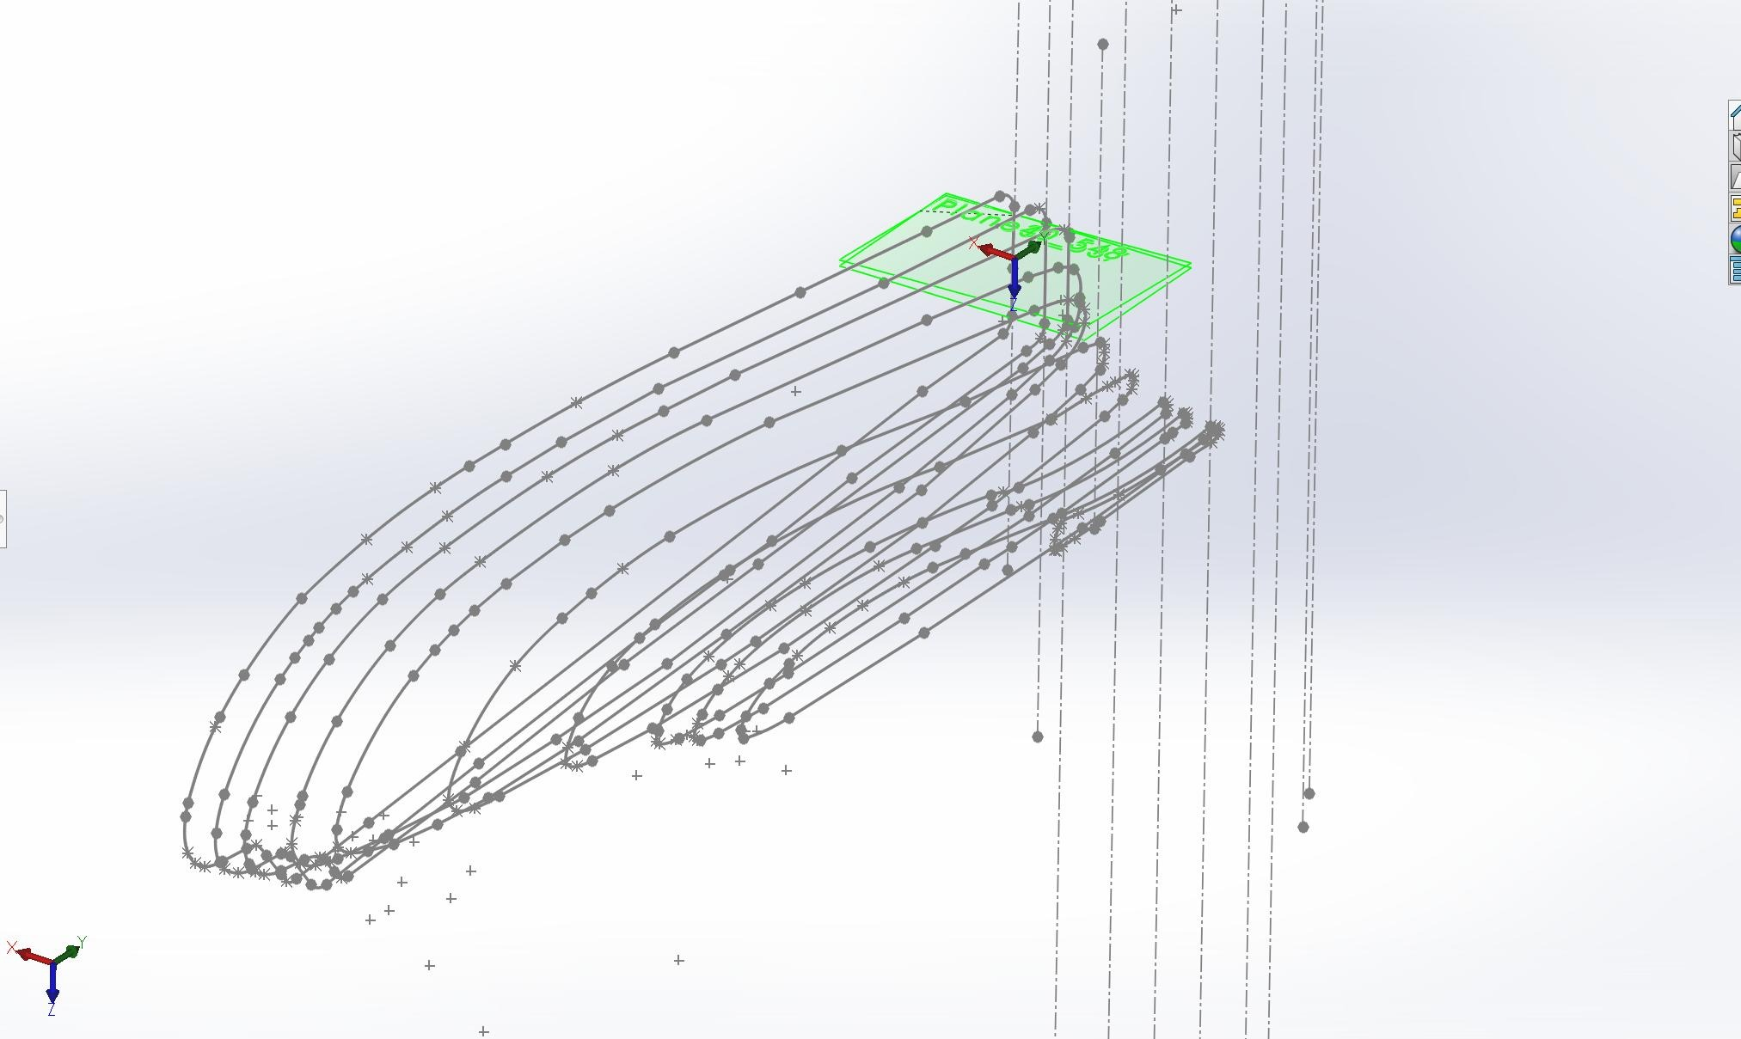
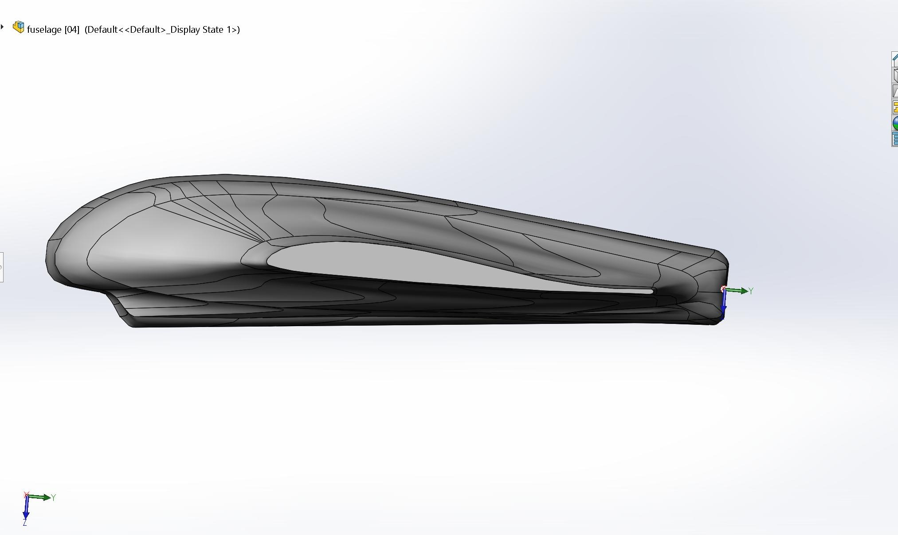
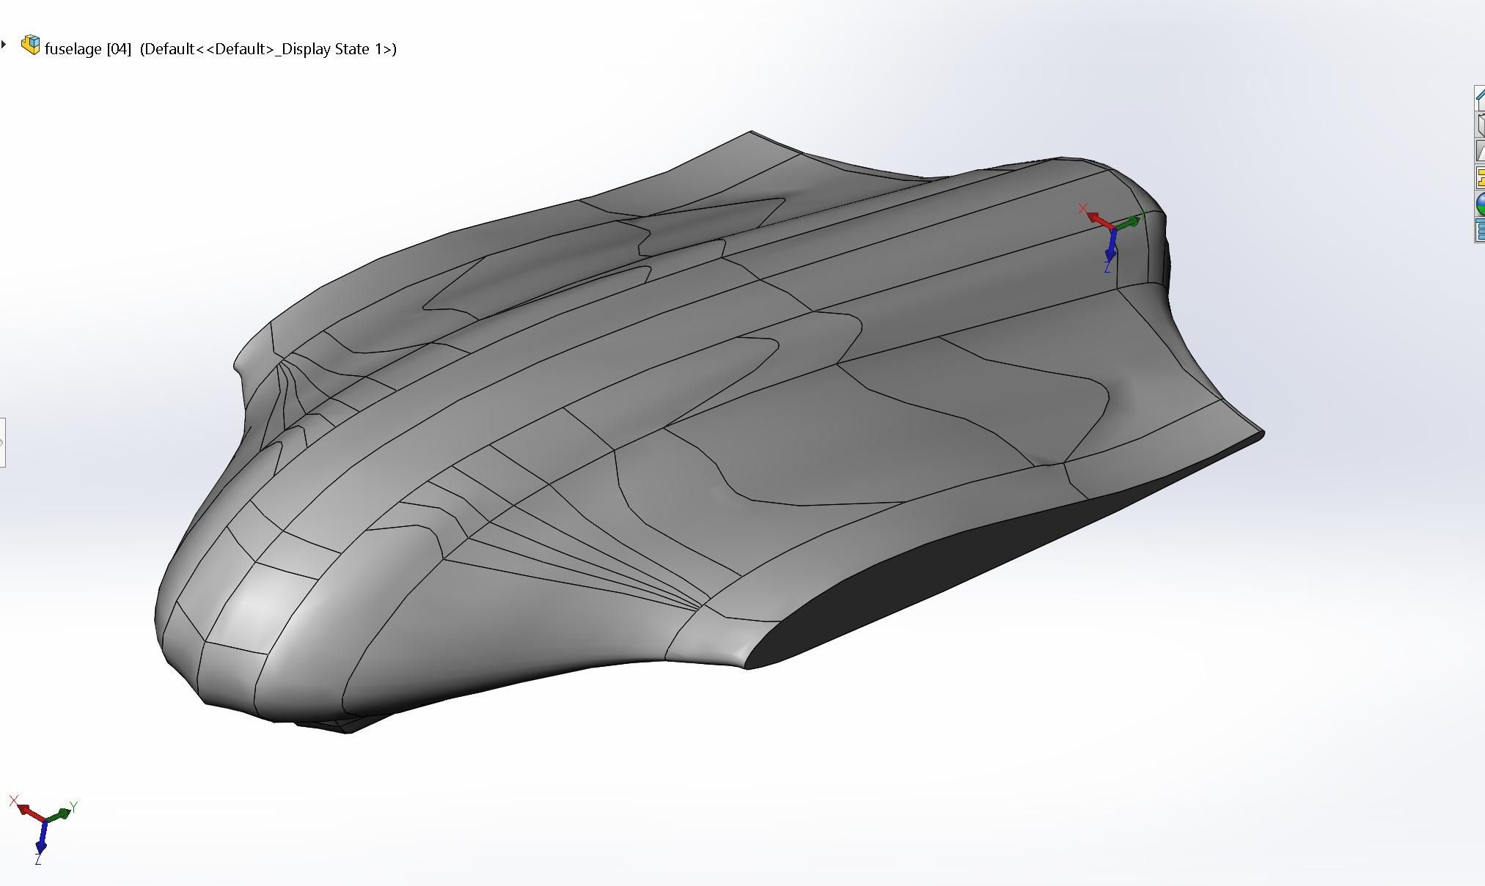
Current progress: CAD drawing of Skywalker X8

Slide 10
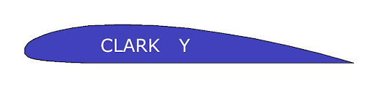
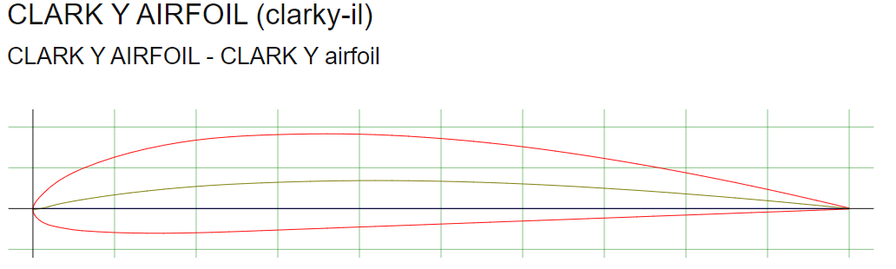
Current progress: Selection of the wings
Clark Y airfoil
Reasonable overall performance in respect of its lift-to-drag ratio
Flat lower surface → easier to make with 3D printed mold

Slide 11
Future plan
02

Slide 12
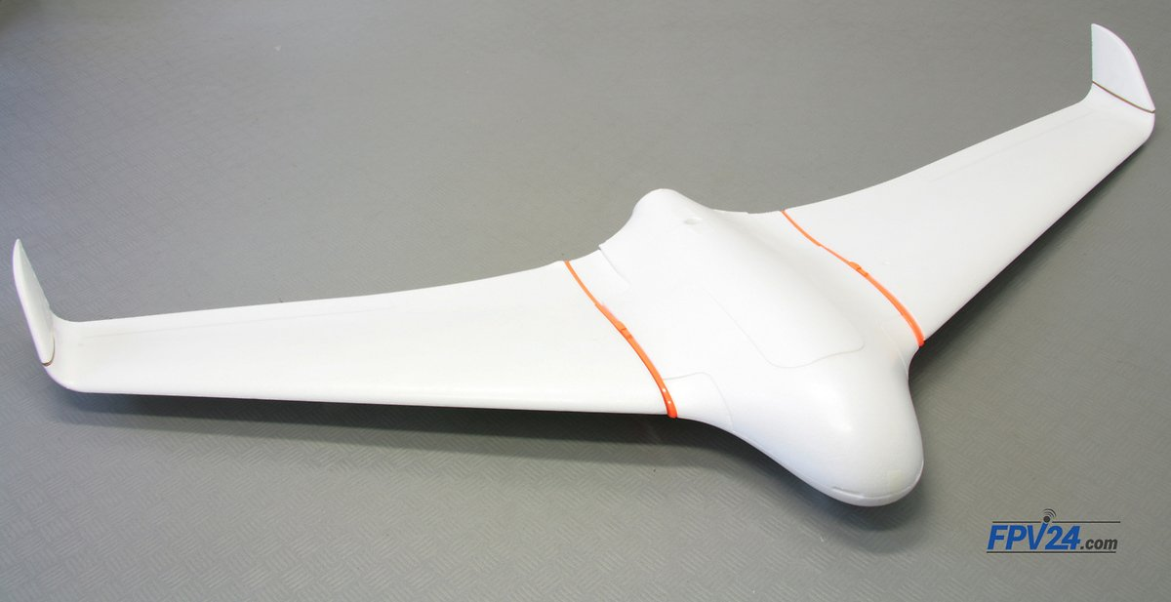
Stages of VTOL UAV Study:
Select reference UAV
Skywalker X8
Select component
Calculation of the motors and learn basic electronics
Build Skywalker X8
Build the electronic parts and mechanics parts
Fly Skywalker X8
Prove its performance and collect relative data

Slide 13
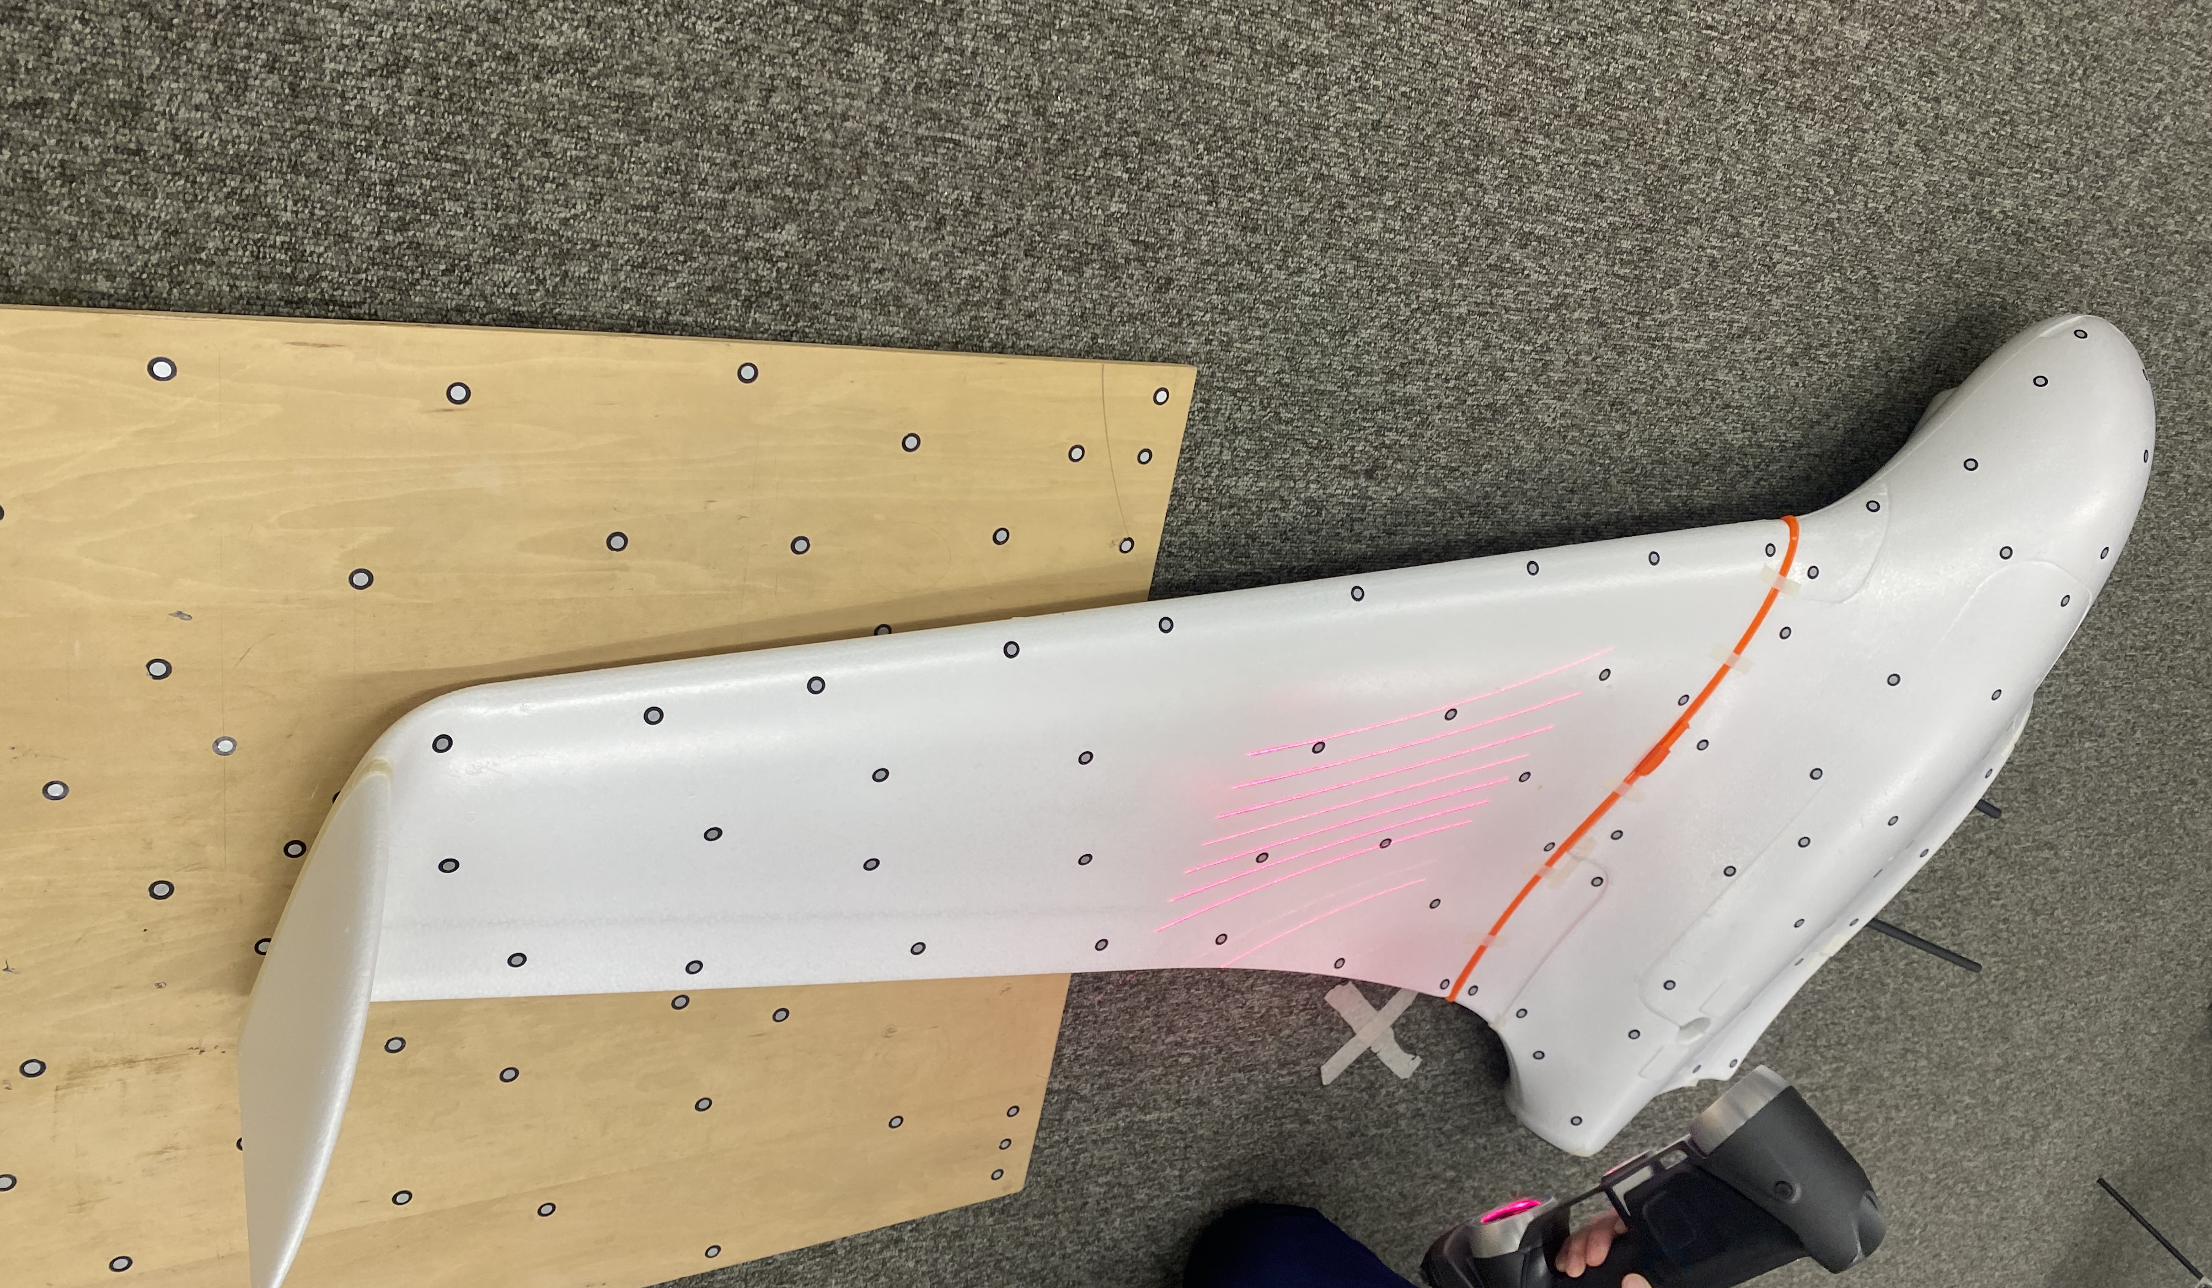
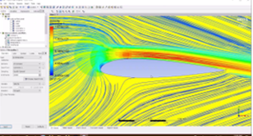
Stages of VTOL UAV Study:
Design CF VTOL UAV
3D scanning & 3D CAD drawing
CF VTOL UAV Simulation + Calculation
Solidworks/ANSYS
Confirm final design and fabricate using molding
Test and fly CF VTOL UAV
Test performance, compare the results with the theories

Slide 14
Gantt chart (from Oct 2021 to Feb 2022)
 | Oct W1-2 | Oct W3-4 | Nov W1-2 | Nov W3-4 | Dec W1-2 | Dec W3-4 | Jan W1-2 | Jan W3-4 | Feb W1-2 | Feb W3-4
Build VTOL X8
X8 fly test and data analysis
Draw CAD (CF mold)
Do simulation & calculation
Make CF VTOL
CF VTOL Test
Write interim report
23 Aug - 5 Nov
10 Nov - 10 Dec
1 Nov - 4 Dec
22 Aug - 31 Dec
15 Nov - 31 Dec
1 Jan - 30 Feb
1 Sep – 22 Nov

Slide 15
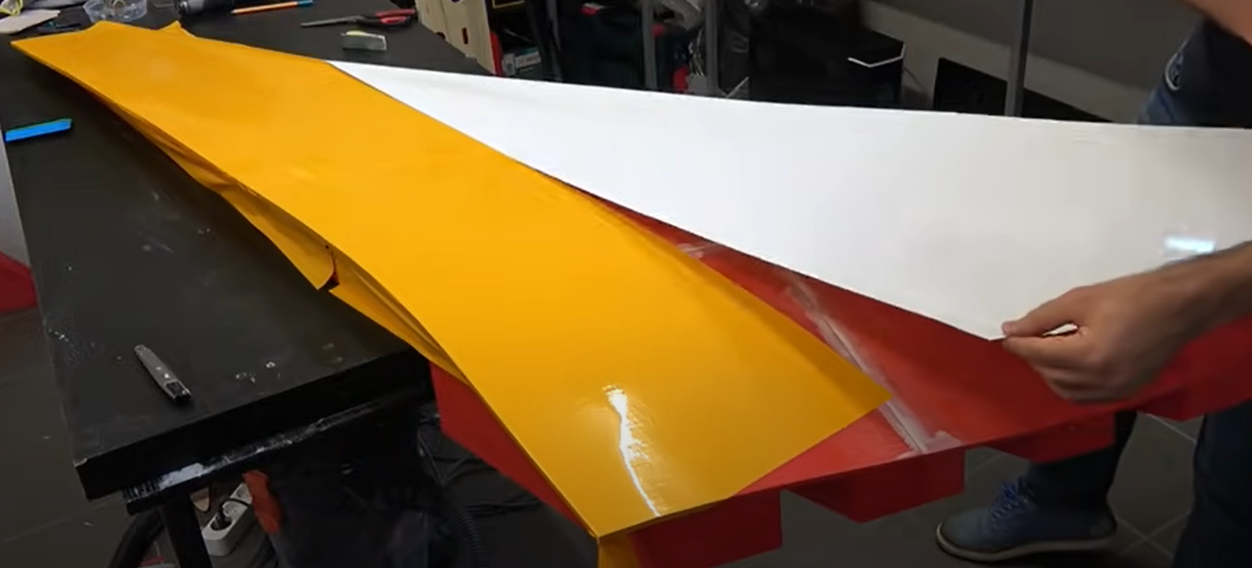
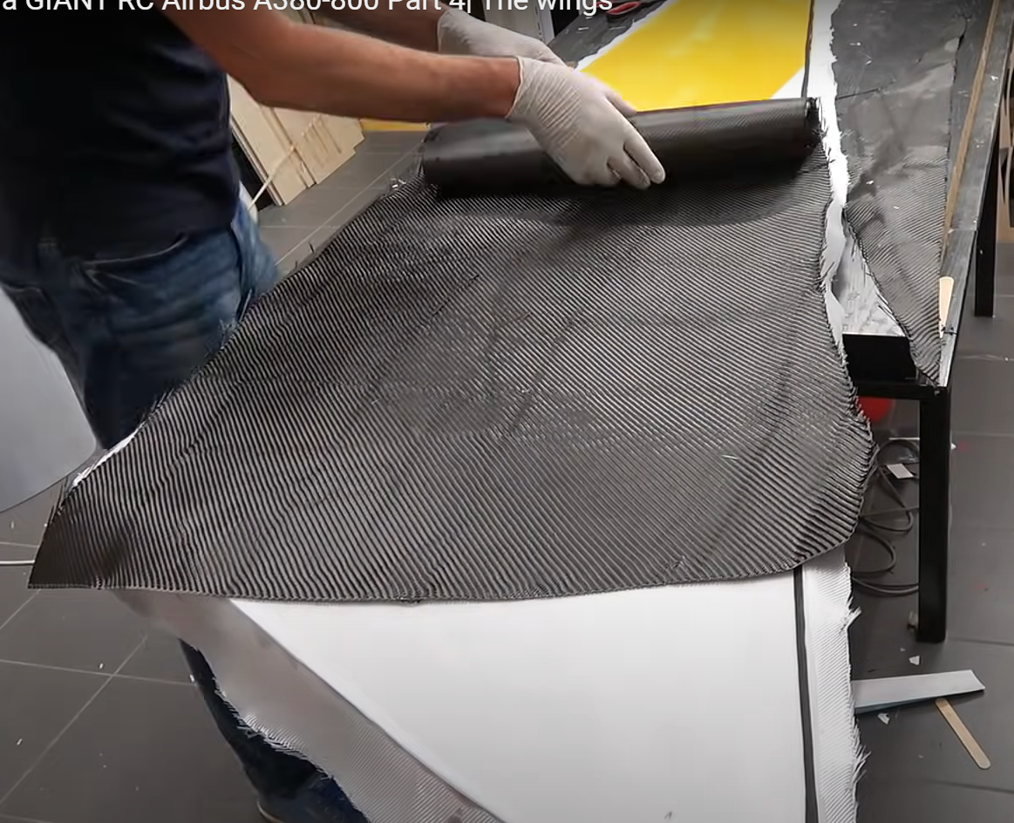
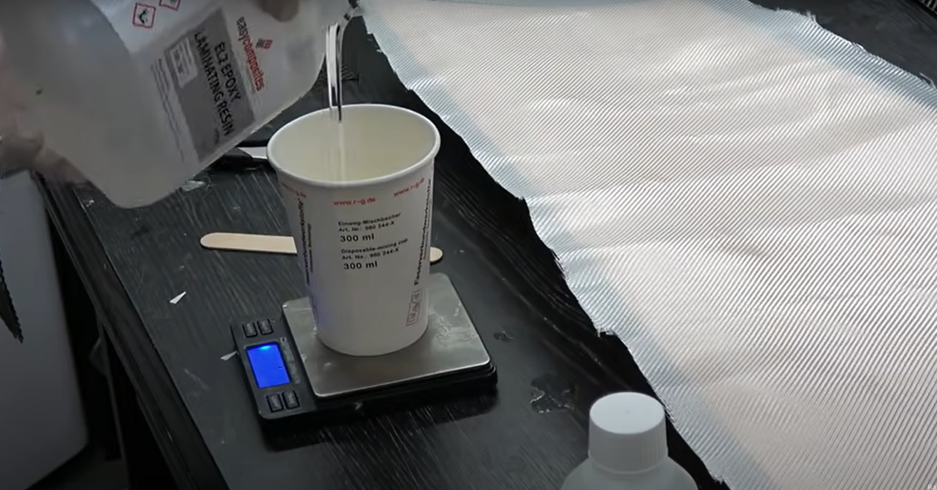
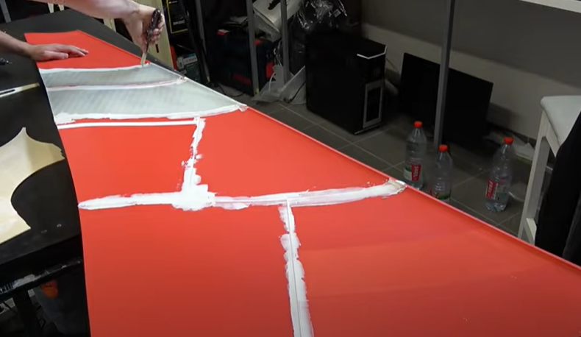
Flow chart of manufacturing CF plane
Cover a plastic sheet
Place and stick the CF cloth & peel ply
3D printing mold

Slide 16
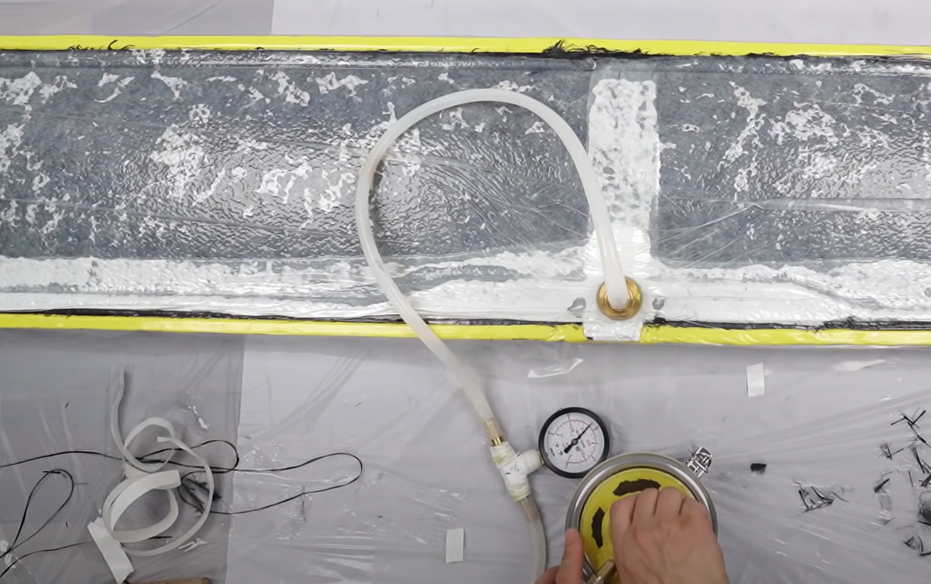
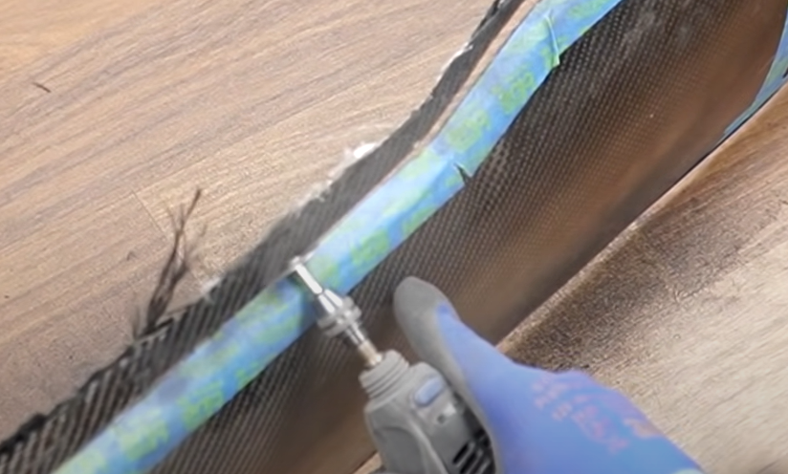
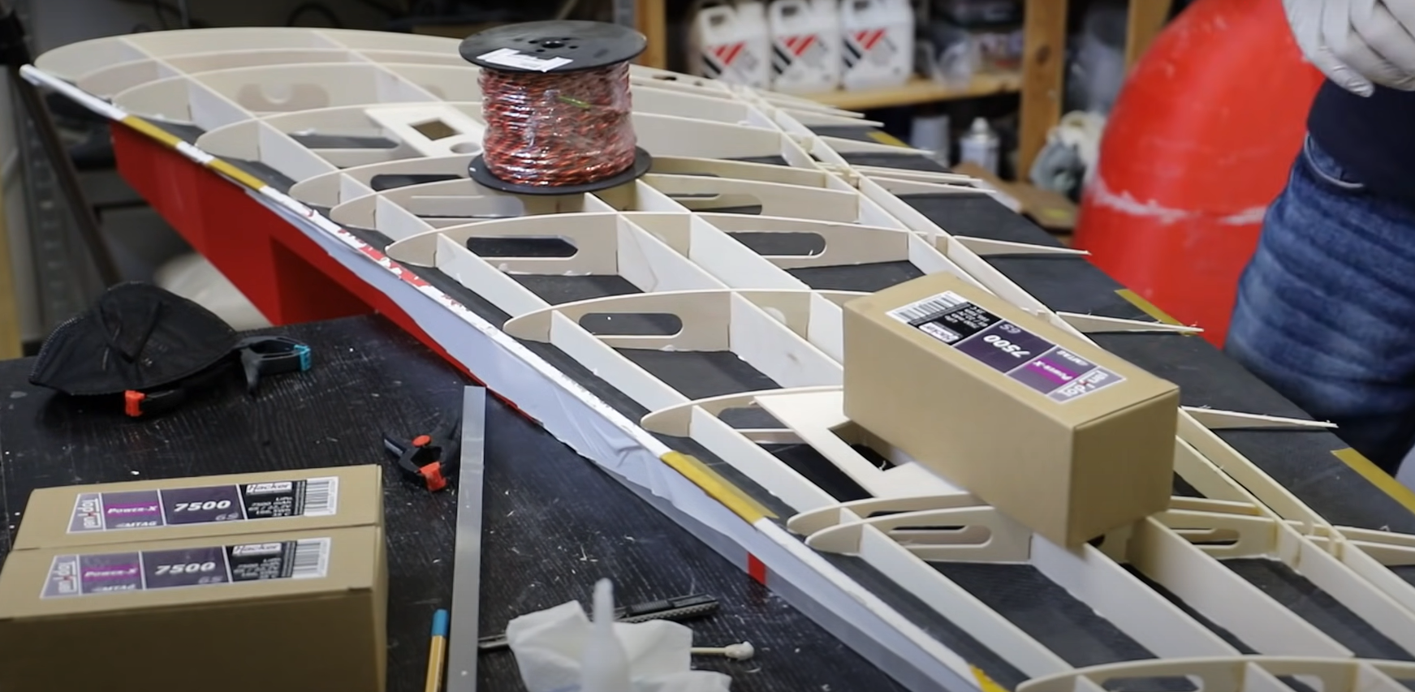
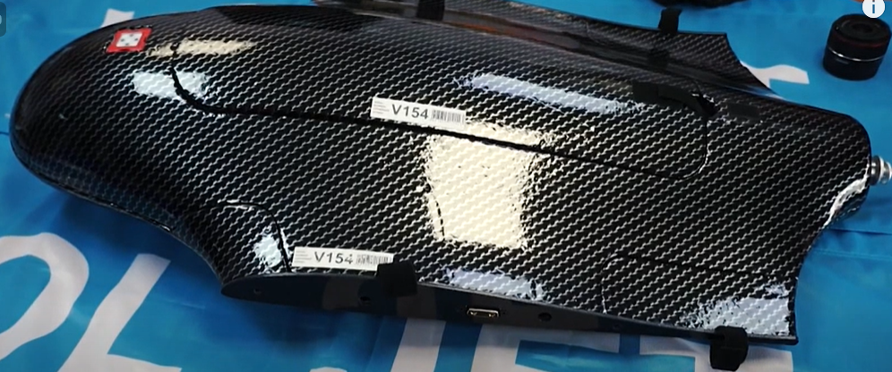
Flow chart of manufacturing CF plane
Stick the supporting structure on one side of the wing
Vacuum (Waiting for 24 hours )
Do finishing
Replace the steps for another side of wing
Stick 2 sides of the wing and do finishing

Slide 17
Interim report
03

Slide 18
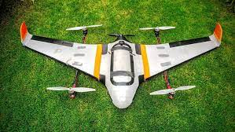
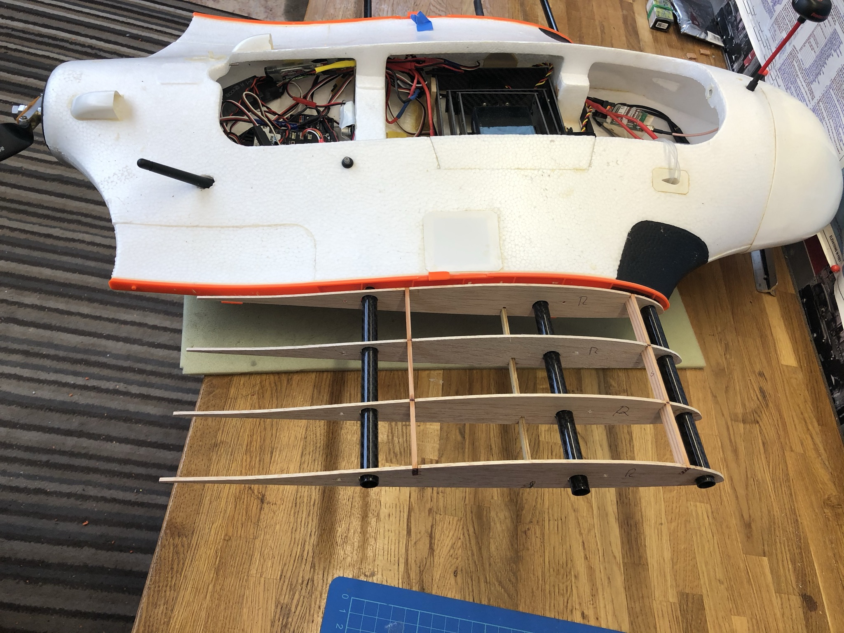
Content
Nomenclature
Introduction
Background
Objective
Literature Review
Methodology
Project Planning
Project Schedule
Gantt Chart
References

Slide 19
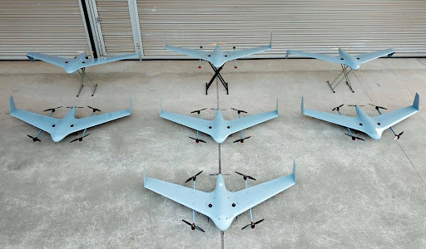
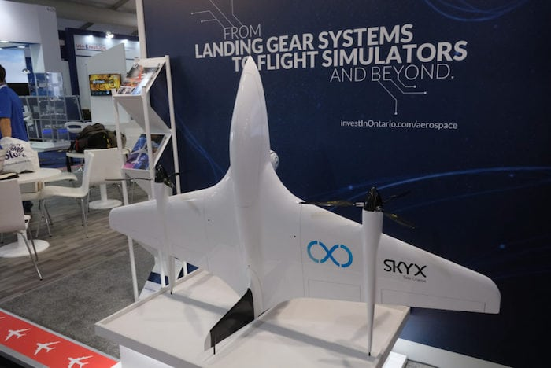
Introduction
Background
Introduction of different VTOL UAVs
Functions and uses of them
Our prototype (X8)
Reasons of the project
Objective
To fly a VTOL UAV to carry a ~1 kg payload
To fly a VTOL UAV with a specific performance
To design a VTOL UAV to complete the above missions with our understanding of kinematic and aerodynamic

Slide 20
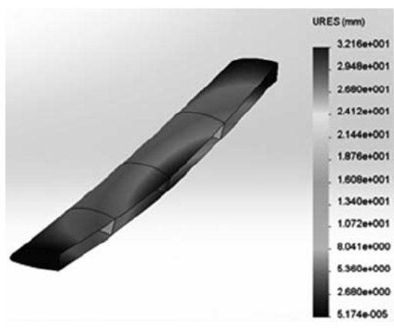
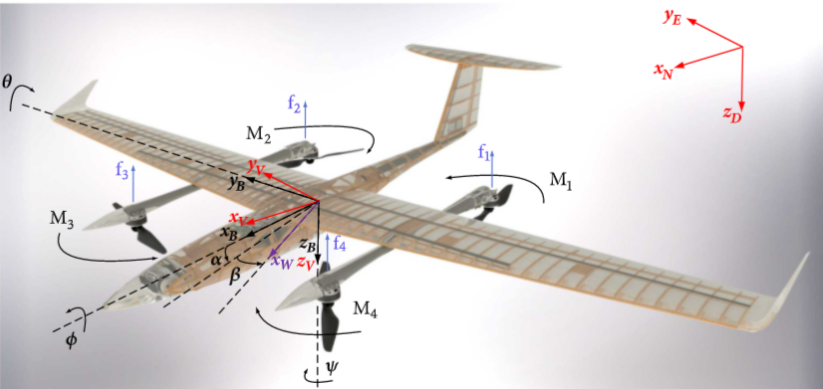
Literature Review
Design & Manufacturing UAV structure by using composite materials
Introduction of VTOL UAV
Aerodynamics of Fixed wing VTOL UAV

Slide 21
Methodology
1. Processes during building Skywalker X8
→ e.g., calculation for the selections of VTOL motors, total weight of UAV
2. Comparison of the flying records of Skywalker X8 and its simulation results
3. Explanation of choosing Clark Y airfoil
4. Processes during building our CF UAV
→ e.g., manufacturing processes of CF parts, design of the support structures
5. Comparison of the flying records or the CF UAV and its simulation results

Slide 22
Project Planning
Project Schedule Highlight
Skywalker X8 building (Early Sep)
Skywalker X8 3D scanning (Mid Sep)
Skywalker X8 CAD drawing from scanned model (Late Sep)
CF wing design (Mid Oct)
CF wing fabrication (Early Nov)
CF UAV building (Mid Nov)
Testing CF UAV (Early Jan)
Final report (Feb)
Gantt Chart
Notes:
(DATE OF FINAL REPORT?)

Slide 23
References
Pixhawk 4 Wiring Quick Start https://docs.px4.io/master/en/assembly/quick_start_pixhawk4.html
Airfoil Tools http://airfoiltools.com/airfoil/details?airfoil=clarky-il Building a GIANT RC Airbus A380-800 Part 4| The wings https://www.youtube.com/watch?v=23Fj1iaz2pU&t=179s&ab_channel=RamyRC
如何製作碳纖維機翼[DIY]（使用3D打印模具） https://www.youtube.com/watch?v=BSv0XuPGUig&t=890s&ab_channel=ECO-LAPStudio
БПЛА VOLJET X8 VTOL RedEdge https://www.youtube.com/watch?v=lVY55hxu3Y8&ab_channel=VolJetAvia
Transition Flight Modeling of a Fixed-Wing VTOL UAV https://link.springer.com/content/pdf/10.1007/s10846-015-0325-9.pdf
Dynamic Modeling of a Fixed-Wing VTOL UAV https://ieeexplore.ieee.org/stamp/stamp.jsp?tp=&arnumber=6842289
Design and manufacture of umanned aerial vehicles(UAV) wing structure using composite materials https://onlinelibrary.wiley.com/doi/epdf/10.1002/mawe.201500351
Construction Prototyping, Flight Dynamics Modeling, and Aerodynamic Analysis of Hybrid VTOL Unmanned Aircraft https://downloads.hindawi.com/journals/jat/2018/7040531.pdf

Slide 24
Thank You

